Slide 1
Applying the Neuman Systems Model to Students' Clinical Experience
Joan Timalonis, MSN, RN, CNE
Sharon Melincavage, DEd, RN, CRNP-BC, CNE

Slide 2
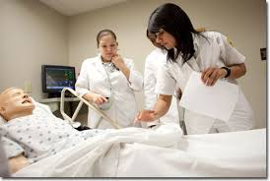
Cedar Crest College

Slide 3
Objectives
1. Discuss the use of the Neuman Systems
Model as a framework for helping students
understand the gestalt of caring for clients
during clinical experiences.
2. Apply the SBAR method of communication to
students' clinical assignment.

Slide 4
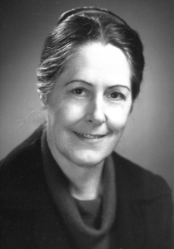
Neuman Systems Model
In 2010, CCC adopted NSM as organizing framework to teach unique focus of nursing in the clinical setting (Lowry, 1998)
Notes:
Helps nurses organize their practice in a variety of settings. (Lowry, L, Beckman, S, Gehrling, K, Fawcett. J, 2007)
NSM provides a broad perspective for actions performed by members of a discipline (Lowry, L, Beckman, S, Gehrling, K, Fawcett. J, 2007)
NSM does not dictate the arrengement of curriculum content. These decisions remain with faculty. Lowry, 1998 p23
Introduction
Interactive Tutorial
Integration
Fundamentals course
Clinical component
Other courses

Slide 5
NSM Practice Guidelines
CCC Nursing Program applied NSM as a guide for nursing practice (Lowry, 1998)
Reviewed NSM Practice tools shared by Dr. Lowry in 2008 and 2009 (Dr. Lowry, personal communication)
Notes:
Chapter 8 of 5th edition of the Neuman Systems Model. (Neuman & Fawcett 2011)
Fit nicely with use of nursing process.
***Need more explanation of this slide

Slide 6
Transformation of Existing Practice Tools in a Fundamentals Course
Applied the NSM to existing practice tools
Clinical Prep Tool
Concept Mapping Assignment
Provided a more wholistic perspective of client care for students
Notes:
Incorporation of 5 Variables (Neuman & Fawcett 2011) – Psychological, Developmental, Sociocultural, Spiritual, Physiological

Slide 7
Original Clinical Prep Tool

Slide 10
Initial revisions to Clinical Prep Tool
Notes:
Our initial assessment Guide
Incorporation of 5 Variables (Neuman & Fawcett 2011) – Psychological, Developmental, Sociocultural, Spiritual, Physiological

Slide 11
Secondary revisions to Clinical Prep Tool

Slide 12
Clinical Prep Tool
Neuman Systems Variables
Psychological
Coping methods
Mood/Affect
Cognitive abilities
Attitudes
Values
Memory
Thought content
Hallucinations
Agitation
Developmental
Developmental stage
Maturational events
Significant life events
Transitions stressors
Role/Occupation
Sociocultural
Access to healthcare
Family resources
Economic status
Family structure
Ethnic-cultural
Language
Literacy
Marital status
Spiritual
Religious beliefs
Spiritual values
Hopefulness
Sacrament of the Sick
Physiological (start systems review)
Revision 1
Revision 2
Notes:
Will put link in here – and make it a title page
Our initial assessment Guide
Incorporation of 5 Variables (Neuman & Fawcett 2011) – Psychological, Developmental, Sociocultural, Spiritual, Physiological

Slide 13
What is a concept map?
“A concept map is a schematic device for representing a set of concept meanings embedded in a framework of propositions.” (Novak & Gowin, 1984, p. 15)
A diagram that reveals how concepts are related to each other
Concepts are placed in a particular shape and the shapes are connected by words or phrases that explain the connection between the two (Gerdeman, Lux, Jacko, 2013)
Notes:
We always had the student using a clinical prep tool and then the students developed a care plan with a transition to concept map
Here is a brief overview of what a concept map is and some research on concept maps in nursing education.
How many of you use concept maps and its relation to providing patient care

Slide 14
What is a concept map (cont.)
Can be used as a teaching strategy to foster critical thinking in students (Taylor, Littleton-Kearney, 2011)
Critical thinking is a necessary skill for making important patient care decisions (Vacek, 2009)

Slide 15
Concept Map Research
The experimental group had higher scores of inference and deduction on the Critical Thinking Scale than the control group
Results may be related to concept mapping because students need to draw logical conclusions from factual knowledge by making inferences (Lee, Chiang, Liao, Lee, Chen, Liang, 2013)
Notes:
Lee, Chiange, Liao, Lee, Chen, Liang 2013 – The longitudinal effect of concept map teaching on critical thinking of nursing students
The experimental group was taught how to construct a concept map in the first week of class
Instructors summarized course content at the end of classes with concept maps in addition to lectures and guided students to work on course assignments using concept mapping techniques

Slide 16
Concept Map Research (cont.)
Problem-based learning and concept mapping (PBL-CM) techniques combined
Students in the experimental group scored significantly higher on 3 reliable scales post-test and follow-up test (Scales – CTS, SDLS, SPIPTSQ)
Experimental group had significant growth compared to control group at post-test
PBL-CM method had long-term effect on critical thinking (Tseng, Chou, Wang, Ko, Jian, Weng, 2011).
Notes:
Tseng, Chou, Wang, Ko, Jian, Weng, 2011 – The effectiveness of problem-based learning and concept mapping among Taiwanese registered nurse students
Experimental group had a 3 hour introduction to problem-based learning and 2 hours of application of concept mapping
They had 3 hours of PBL tutorials and concept map construction each week for 14-weeks for a total of 42 hours
CTS – Critical Thinking Scale
SDLS – Self-Directed Learning Scale
SPIPTSQ – Students’ Performance in PBL Tutorial Sessions Questionnaire

Slide 17
Concept Map Research (cont.)
Treatment of concept mapping had a statistically significant effect increasing the deep approach to learning scores during a 15-week semester as measured on a reliable and valid tool (revised Study Process Questionnaire-2 Factor [rSPQ-2F]) (August-Brady, 2005)
Notes:
The effect of a metacognitive intervention on approach to and self-regulation of learning in baccalaureate nursing students August-Brady, 2005
Treatment group received
a. A 1-hour session on the use of concept mapping and then given a case study to construct a concept map
b. They received a written directive on how to construct concept maps and additional readings
c. Treatment participants were required to complete 6 concept maps on six assigned patients as part of their clinical preparation during the 15-week semester

Slide 18
NSM : A Visual Representation
Neuman's model is a visual representation, for thinking about humans, and nurses, and their interactions (Heyman & Wolfe, 2000)
Notes:
(Neumans System's Model, written and presented by Patrick Heyman and Sandra Wolfe, University of Florida, April 2000)
http://patheyman.com/essays/neuman/short.htm
***While this is old – this is original work about the concept map
This online reference was used a great deal in making changes in particular to create a glossary for students

Slide 19
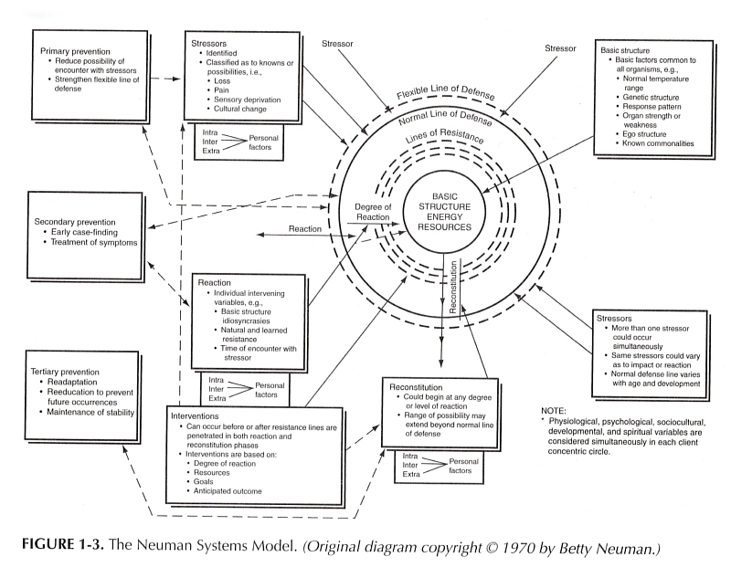
Notes:
When looking at the definition of a concept map, this is it that Dr. Neuman created
It connects concepts together
One of the purposes of a concept map is that all inter-linking patient needs and interventions are presented all on one pages

Slide 20
Concept Mapping Assignment
Notes:
This is old visual representation – nothing about Neuman, very physiologic, a lot of medical dx, lacked nursing terminology
We had the beginnings of a systems model with our original concept mapping with the patient at the center or the core but it was lacking meeting patients wholistiic needs, addressing all the variables that address patient care
Once again, it has more a physiologic or even medical viewpoint rather than nursing

Slide 21
Notes:
p. 210 of the Neuman Systems Model – 5th edition
This is the revised concept map that is used today and incorporates the wholistic view : Center is Client system: Basic Structure or Central Core: Used to put VS in core, But in the hospital setting difficult to have normal temp. etc. So the Basic Factor common to the patient during hospital stay is ?Dev/stage? Ego structure. Surrounding client are LOD, LOR
One stressor is not physiologic
Includes areas for positive variables aiding defense and resistance
The client at the core the NURSE has to consider all the lines of resistance and defense and the degree that the stressors penetrate
Considers a systematic view of the patients – ex. Genetics, pt strengths and weakness
Previously we discussed only Chief Complaint and History of Present Illness, now we incorporated Dr. Neuman’s basic structure of the client system with the concentric rings and circles
We’ve gleaned from Dr. Neuman’s model the pertinent pieces of her systems approach to help students look at patients with a wholistic lens – it’s a start

Slide 22
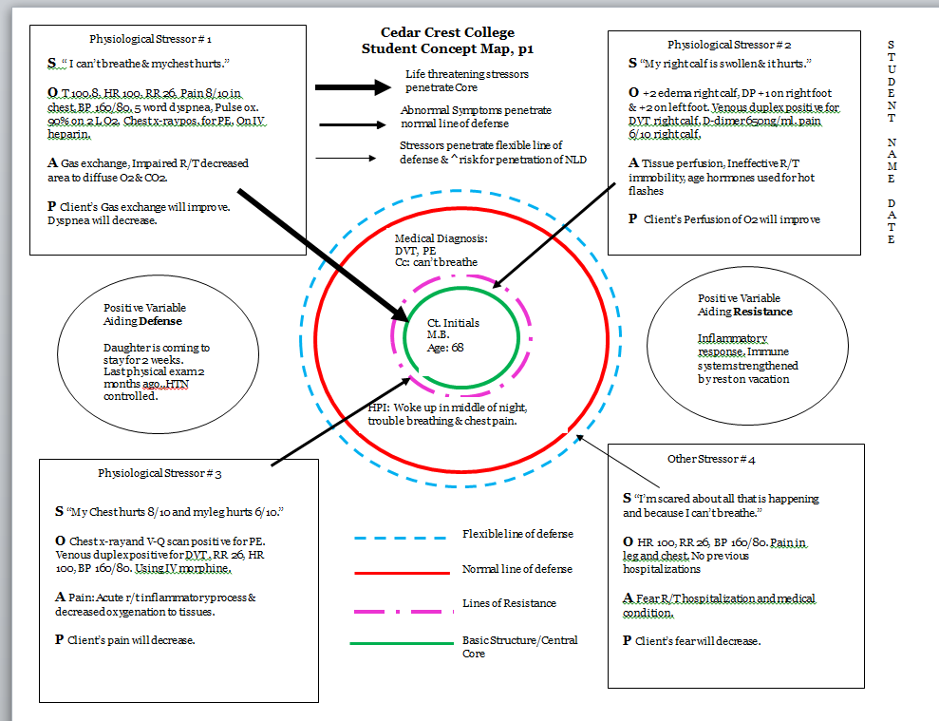
The Client System
Notes:
Identify 4 priority problems, one non-physiological
Arrows to show penetration of Clients FLD, NLD LOR to identify priority stressors
In wellness & illness states, all variables affecting the client must be evaluated & inter-relationships identified. (Neuman & Fawcett, 2011)
The Nursing process is shaped by unique patient preferences, needs, values and choices (ANA Code of Ethics, 2015)
In this assignment students need to prioritize stressors and show how the stressors penetrate the lines of defense as per the Neuman Systems Model
Identification of Positive Variables
In wellness & illness states, all variables affecting the client must be evaluated & inter-relationships identified. (Neuman & Fawcett, 2011)
The Nursing process is shaped by unique patient preferences, needs, values and choices (ANA Code of Ethics, 2015)
Stressors Affect system stability.

Slide 23
Priority Stressors Identified
Notes:
A 5 variables identified on Prep Sheet or assessment tool
Here’s a close up on how we guide students to illustrate priorities for patients

Slide 24
Secondary Prevention Measures
Notes:
A true concept map would have everything on the same page
To teach fundamental students about interventions we took a linear approach
A true concept map would be somewhat confusing for students to make conncections
This linear format incorporates the nursing process of behavioral outcomes and interventions to meet the behavioral outcomes and evaluation or patient response
There would be a lot to put on one page for NUR 309 students and may hinder learning about interventions and evaluation of interventions
Titled secondary preventions because students are not thinking primary preventions because clinical is in the acute care setting
Secondary prevention per Dr. Neuman – attain previous level of wellness

Slide 25
www.austincc.edu

Slide 26
Fundamentals Students’ Concept Maps
Visual Representation of Client System with Stressors on first page
Secondary Prevention Measures subsequent pages
Sample

Slide 29
SBAR Communication
SBAR (Situation-Background-Assessment-Recommendation)
Technique used to provide a framework for communication between members of the health care team about a patient’s condition (https://innovations.ahrq.gov/qualitytools/sbar-technique-communication-situational-briefing-model)
Notes:
https://innovations.ahrq.gov/qualitytools/sbar-technique-communication-situational-briefing-model
SBAR is one of the Teamwork tools help to help improve communication and foster a culture of safety
One of the tools in the TeamSTEPPS® curriculum(http://www.ahrq.gov/professionals/education/curriculumtools/teamstepps/instructor/fundamentals/module3/igcommunication.html)

Slide 30
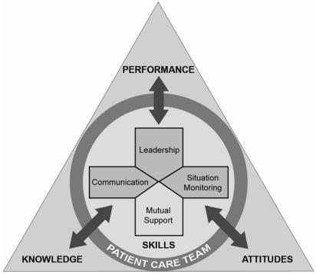
TeamSTEPPS® Strategies
Team Strategies and Tools to Enhance Performance and Patient Safety
Evidenced-Based (King, Battles, Baker, Alonso, Salas, Webster, Toomey, Salisbury, 2008)
TeamSTEPPS instructional framework
TeamStepps Curriculum
Notes:
http://www.ncbi.nlm.nih.gov/books/NBK43686/
Advances in Patient Safety: New Directions and Alternative Approaches (Vol. 3: Performance and Tools)
Edited by Kerm Henriksen, PhD, James B Battles, PhD, Margaret A Keyes, MA, and Mary L Grady, BS.
Rockville (MD): Agency for Healthcare Research and Quality (US); 2008 Aug.Publication No.: 08-0034-3
Copyright and Permissions
TeamSTEPPS™: Team Strategies and Tools to Enhance Performance and Patient Safety
Heidi B. King, MS, CHE, James Battles, PhD, David P. Baker, PhD, Alexander Alonso, PhD, Eduardo Salas, PhD, John Webster, MD, MBA, Lauren Toomey, RN, BSBA, MIS, and Mary Salisbury, RN, MSN Chapter in the above edited book

Slide 31
NSM + TeamSTEPPS® model
Neuman Systems Model
Relevant in the world of healthcare (Lowry, Beckman, Gehrling, Fawcett, 2007)
Helps nurses organize their practice (Lowry, et.al 2007)
“Nurses who practice with the same conceptual model are able to speak the same language and practice consistently.” (Lowry, et.al 2007)
TeamSTEPPS®
A systematic approach to integrate teamwork into practice (King, et.al)
A shared mental model is the outcome (King, et.al)
SBAR communication
Notes:
Lowry also states in The NSM and Nursing Education: Teaching Strategies and Ouctomes, 1998 that teaching and learning from a model (nursing) provides more comprehensive care and high quality outcomes for clients. P.17
Neuman is a systems model but should be inclusive of other models
Here we talk about marrying Neuman with the Team STEPPS approach to promote an element of safety in patient care and incorporated the SBAR approach to patient care

Slide 32
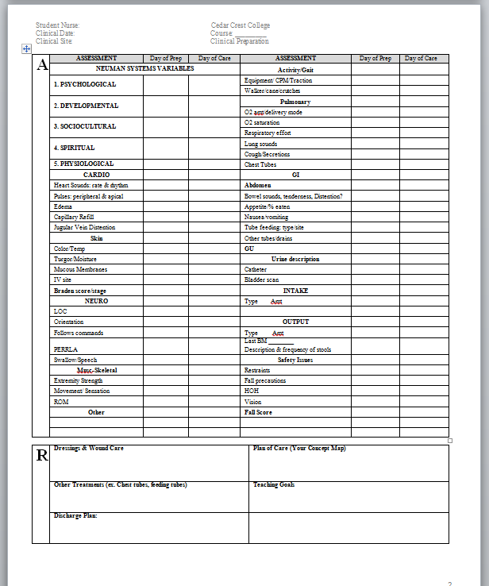
Applied SBAR to Clinical Prep Tool
P1.
P2
Notes:
For Data Gathering & Communication in Fundamentals course

Slide 33
SBAR Communication
SBAR role play improves nursing students’ communication skills (Kesten, 2011)
The mean performance scores of the didactic plus role-play students were significantly higher than those who had didactic instruction alone (t = -2.6, p = 0.005).
Notes:
https://innovations.ahrq.gov/qualitytools/sbar-technique-communication-situational-briefing-model
SBAR is one of the Teamwork tools help to help improve communication and foster a culture of safety
Students who received role-play instruction in addition
to didactic instruction performed significantly better on
the skilled communication first observation than students who
received didactic instruction alone. This finding is the most
interesting aspect of the study as it confirms the relationship
between role-play instruction and performance.
Author: Title: Source: ISSN: DOI: Publisher: Kesten, Karen S. Role-Play Using SBAR Technique to Improve Observed Communication Skills in Senior Nursing Students J Nurs Educ 50 no2 F 2011 p. 79-87 0148-4834 10.3928/01484834-20101230-02 Slack, Inc. 6900 Grove Road, Thorofare, NJ 08086-9447

Slide 34
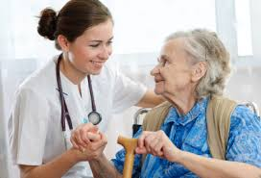
Wholistic Apporach to Client Care
SBAR Clinical Prep Tool
Concept Map Assignment

Slide 37
Application in Other Nursing Clinical Experiences
Client with COPD
Client with altered mental status
Pediatric client
Client with Dehydration
Notes:
Before clinicals begin
NUR 309
NUR 313
NUR 321
NUR 330
NUR 342

Slide 38
Application in Other Nursing Clinical Experiences
Client with COPD
Client with altered mental status
Pediatric client
Client with Dehydration
Notes:
Before clinicals begin
NUR 309
NUR 313
NUR 321
NUR 330
NUR 342

Slide 42
Next Steps?
Continue to encourage faculty in higher level courses to emphasize the Neuman Systems model for clinical
Notes:
“BY the time of Graduation, the students have internalized the NSM as a comprehensive process for providing care.” (Beckman, Lowry & Boxley-Harges, The Neuman Systems Model, p.194)

Slide 43
Summary
This presentation described the re-structuring of clinical prep and concept map assignments using the Neuman Systems Model.
Demonstrated how fundamentals students apply NSM practice guidelines to help consider the gestalt of multiple factors that comprise client care rather than focusing primarily on the client's medical diagnosis
Notes:
***Need to add something about SBAR

Slide 44
References
August-Brady, M. (2005). The effect of a metacognitive intervention on approach to and self-regulation of learning in baccalaureate nursing students. Journal of Nursing Education, 44 (7), 297- 304.
Gerdeman, J.L., Lux, K., & Jacko, J. (2013). Using concept mapping to
build clinical judgement skills. Nurse Education in Practice, 13, 11-17.
Heyman, P., & Wolfe, S. (2000). Neuman Systems Model: In short. Retrieved from http://patheyman.com/essays/neuman/short.htm
King, H. B., Battles, J., Baker, D. P., Alonso, A., Salas, E., Webster, J., Toomey, L., Salisbury, M. (2008). Advances in Patient Safety: New Directions and Alternative Approaches: Vol. 3: Performance and Tools. Retrieved from http://www.ncbi.nlm.nih.gov/books/NBK43686/

Slide 45
References (cont.)
Lee, W., Chiang, C, Liao, I., Lee, M, Chen, S., Liang, T. (2013). The longitudinal effect of concept map teaching on critical thinking of nursing students. Nurse Education Today, 33,219-1223.
Lowry, L. (Ed.). (1998). The Neuman Systems Model and Nursing Education: Teaching Strategies and Outcomes. Indianapolis, IN: Sigma Theta Tau International.
Lowry, L., Beckman, S., Gehrling, K., Fawcett, J. (2007). Imagining nursing practice: The Neuman Systems Model in 2050. Nursing Science Quarterly, 20(3), 226-229.
Novak, J. D., & Gowin, D. B. (1984). Learning how to learn. New York: Cambridge University Press.

Slide 46
References (cont.)
Taylor, L.A., Littleton-Kearney, M. (2011). Concept mapping: A distinctive educational approach to foster critical thinking. Nurse Educator, 36(2), 84-88.
Tseng, H., Chou, F., Wang, H., Ko, H., Jian, S, Weng, W. (2011). The effectivenss of problem-based learning and concept mapping among Taiwanese registered nurse students. Nurse Education Today, 31, 41-46.
Vacek, J. E. (2009). Using a conceptual approach with concept mapping to promote critical thinking. Journal of Nursing Education, 48(1), 45-48.

Slide 47
Questions?
Contact Information:
jttimalo@cedarcrest.edu
smmelinc@cedarcrest.edu

