Slide 1
14th Neuman Systems Model International Biennial Symposium
The Neuman Systems Model:
A Force for Energizing Nursing
Practice, Research, Teaching, & Administration
June 6-8, 2013
Vancouver, British Columbia
Canada

Slide 2
Inspirations in Education
Sarah Beckman, MSN, BS, RN
Associate Professor
NSM Trustee

Slide 3
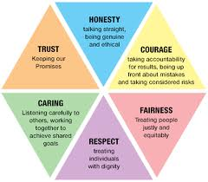
Inspirations
People
Values

Slide 4
Role models
8…10…12…13…19…
Episodic memory (happy)
Caring & respect
Successful outcomes inspire
Build on prior learning

Slide 7
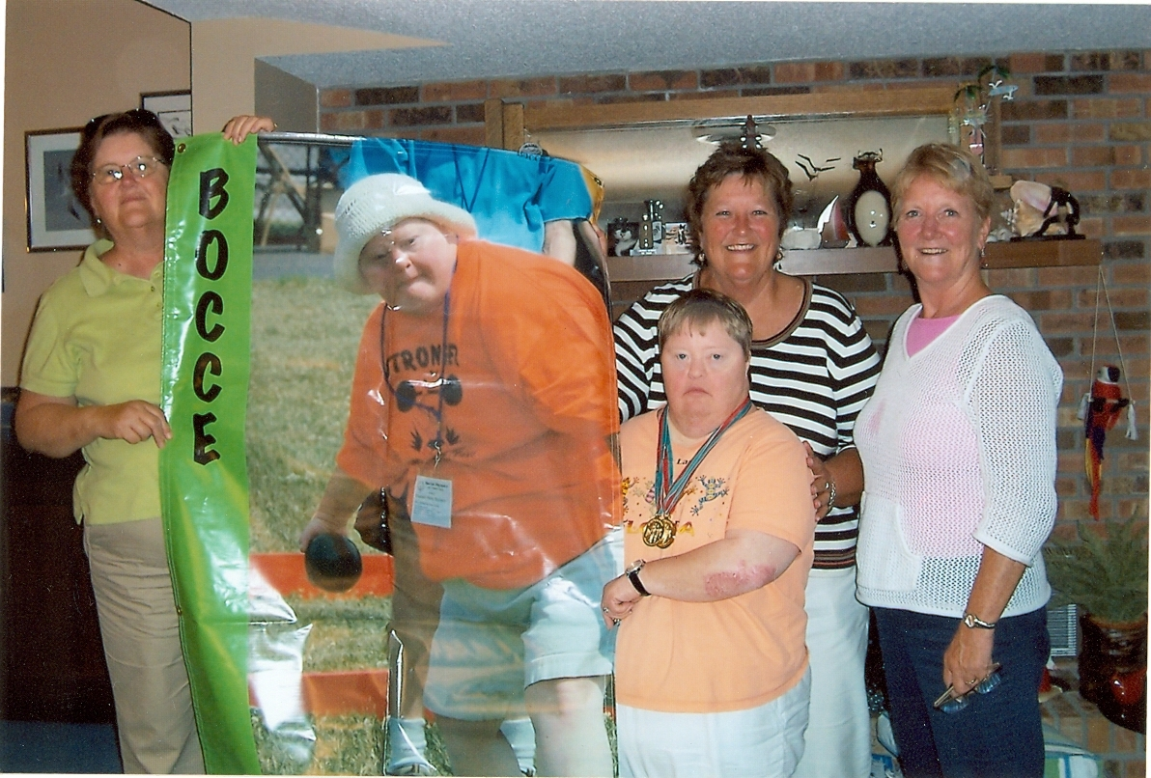

Slide 8
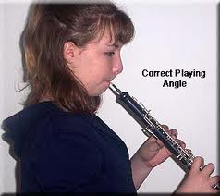
It’s OK
next time tell me so we can get you a new one
Episodic memory (sad)
Caring and respect when you really need it vs criticism
Reinforcement-positive and/or corrective
Years later…I was thrilled that you did not start crying, or even worse, get up and walk out

Slide 9
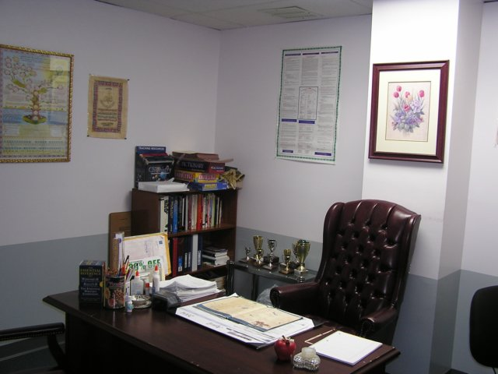
If you are wondering –
this is the principal’s office
Episodic memory (fear)
Mischief will inspire, or else…
Fairness, trust is earned
Collaborative learning with peers

Slide 10
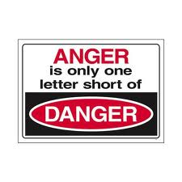
Can’t wait to go to college, can’t stand it here anymore!
Episodic memory (anger)
Amygdalla Hijack …take it back later
Honesty and courage to apologize
(Goleman, 1998)
Alone, too proud, show her…
Years later…It did hurt. I knew you needed to go.

Slide 11
College 1972-1976
Goal-oriented, nursing, social life
Expanding awareness
Ball State London Center
12 credits – art, music, geography, speech
Theatre, opera, fish/chips, double decker bus, art at Tate Gallery
Diversity!! language, customs, beliefs, practices, clothes, food, church/temple/mosque, sights, sounds, smells
(Risk taking, multiple stimulation of senses, collaborative learning with peers,
all adult learning principles activated)

Slide 12
BS RN 1976 Indiana University Medical Center
Staff, charge, patient care coordinator, manager
Professional practice
Patients (1st code, 2nd code, …)
New hires
Students - nursing, medical, PT, OT, RT, chaplain, pharmacy, etc
Employees - post surgical unit
Professional Service
Nursing Honor Society STTI
American Nurses Association
Research
Influence of staff development on pain management
Publication
Photo Atlas of Nursing Procedures (1984)
(Reality-based practice, education, research, administration)

Slide 13
IU School of Nursing
Graduate Education - Nursing Administration
Nursing Theorists and Their Works (1986) 1st edition
Clinical faculty

Slide 14
1976 Professional nursing practice
Patient-centered care
Collaboration with the interdisciplinary team
Best practices
pain management, interdisciplinary rounds, bedside report, 24 hour chart checks, patient identifiers, etc
Audits
Medication errors, falls, etc
Hard copy patient medical record, long hand notes
It was natural to think our job was to keep patients safe, deliver quality care, be connected, be genuine

Slide 15
Goodness of Fit 1989 to present
Application interview
Philosophy on entry into professional practice?
Value of nursing theory-based education?
Faculty responsibilities – teach, scholarship, service
Medical-surgical
300 level concepts & theories
300 level transcultural healthcare
400 level leadership in nursing
(Beckman, Boxley-Harges, & Kaskel, 2012)

Slide 16
Theory Inspires Excellence (Neuman 1989, p.26)

Slide 17
Colleagues Inspire Excellence (Neuman,1989, p.302) Sanna Boxley-Harges

Slide 18
Academy – Scholarship
Presentations – local, regional, international
3rd NSM Symposium in Dayton, Ohio
I am so proud of your work at IPFW, please say hello to Elaine (B.Neuman)
I would be delighted to work with you (L.Lowry)
Encouragement, advice, guidance, & caring attitude
People, values, standards, and NSM-based program outcomes
Publications
Nursing Theorists and Their Works (1994)
The Neuman Systems Model and Nursing Education (1998)

Slide 19
Research Inspires Excellence Seek to know and understand
NSM-based program outcomes
LJNMEI replication study
At graduation & 9 months after graduation
Graduates positive, reveal learning, value NSM
Alumni more positive ratings using NSM as a guiding framework for professional nursing practice
Internalization of the NSM became stronger after graduation when working as a registered nurse
(Beckman, Boxley-Harges, Bruick-Sorge, & Eichenauer, 1998)

Slide 20
-based curriculum Teaching, research, service
NSM Spirituality
Research
(Salmon, Bruik-Sorge, Beckman, & Boxley-Harges, 2010)
Teaching
(Beckman, Boxley-Harges, Bruick-Sorge, & Salmon, 2007)
Service
NSM symposia, STTI conventions, Lilly Teaching conferences

Slide 21
1976 to 2013 Fast forward
Recall 1976 Professional Practice
Some things very similar
Some things very different

Slide 22
Very Similar
1976
2013
Patient-centered care
Interdisciplinary teamwork
Best practices
Outcome audits
Hard copy patient medical record
It was natural to think our job was to keep patients safe
Patient-centered care
Interdisciplinary teamwork
Evidence-based practice
Quality Improvement
Informatics – electronic health record (EHR)
Safety
Institute of Medicine (IOM)

Slide 23
Very Similar
1976
2013
physiological, psychological, spiritual,
…somewhat developmental,
……..less so about socio-cultural
physiological,
Psychological,
Spiritual,
Developmental,
….expanded awareness, sensitivity, competence
Socio-cultural (diversity)

Slide 24
2013 Driving Forces for Excellence
1976 Similar
2013 Different
People are people
Person in bed
Sick patients
Quality care
To be kept informed
Respect
Fear of pain
Fear of dying alone
Stressors
Intra
Inter
Extra
Boomers vs millenials
Patient-Client-Consumer-Customer
7 day stay ---23 hour stay – 2 hour
Acuity
Genome, genetics
Aging population
Morning after pill over the counter
Nanosecond
Information systems – EHR
Educational technologies
Access to global lit resources
Transparent reporting of care outcomes
HCAHPS

Slide 25
Institute of Medicine (IOM) Quality & Safety Education for Nurses (QSEN) inspire excellence
Patient-centered care
Collaboration with the interdisciplinary team
Evidence-based practice
Quality improvement (transparent reporting)
Informatics (EHR, smart bed, smart phone, smart …)
Safety (fast paced, acuity, long shifts, etc)

Slide 26
Evidence-based Practice Inspires
Fire Starter Publishing. (2013). The HCAHPS Handbook. Retrieved 1 April 2013 from http://www.firestarterpublishing.com/dotCMS/detailProduct?categoryInode=106219&categoryName=&orderBy=&page=0&pageSize=0&direction=&filter=&inode=663849&bulk=false

Slide 27
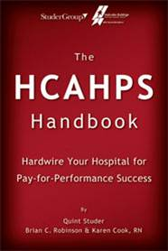
2013 NSM & Transparent reporting Driving Forces for Excellence
Hospital Consumer Assessment of Healthcare Providers & Systems
The HCAHPS survey (27 questions)contains
18 patient perspectives on care and patient rating
items that encompass eight key topics:
1. communication with doctors,
2. communication with nurses,
3. responsiveness of hospital staff,
4. pain management,
5. communication about medicines,
6. discharge information,
7. cleanliness of the hospital environment, and
8. quietness of the hospital environment.
http://www.hcahpsonline.org/Files/March%202013%20HCAHPS%20Intro%20Training%20Slides%20Session%20I_3-4-13.pdf
(Lowry, Beckman, Gehrling, & Fawcett, 2007)

Slide 28
Learning Outcomes Inspire
Medication Errors
http://prezi.com/xrcra-6tkvgn/edit/?auth_key=s18oq7p&follow=ab_mtnof9mkl
Falls
NDNQI Falls and Falls with Injury
Patient Centered Care
http://prezi.com/x33jxmcwnlzd/patient-centered-care-group-3/?kw=view-x33jxmcwnlzd&rc=ref-32490379
Nurse Satisfaction
http://prezi.com/hdaytn4zoe3u/copy-of-assignment-3-nurse-satisfaction/?auth_key=0749452837d1cb52774d06f8999ae0b16da5595f&kw=view-hdaytn4zoe3u&rc=ref-31266397
(Keller, 2008; Whitehead, Weiss, & Tappen, 2010)

Slide 29
Learning Outcomes Inspire
Collaboration with Interdisciplinary Team
http://prezi.com/dav1-qyveywk/iom-interdisciplinary-collaborative-teamwork/?kw=view-dav1-qyveywk&rc=ref-33779189
Social Media
http://prezi.com/-f3ioayz-rwj/edit/?auth_key=5sis1du&follow=lw7lvxvfvqgb
Patient Satisfaction
Educating Our Patients on New Medications
(Keller, 2008; Whitehead, Weiss, & Tappen, 2010)

Slide 30
NSM applied to ED setting
This is one for the Book!
Reflection is a beautiful thing!!
…and less emotional
… my art work inspired

Slide 31
NUR 44200 Leadership in Nursing
90 hour clinical with a preceptor
Quality Improvement Project
Major challenges getting started
Lack of focus, lack of direction
Irritation, frustration, disappointment
Anger at times
Three students, three preceptors – One project
Clinical faculty (ongoing consultation with me)
Semester deadlines fast approaching
3rd visit by one student, calls from other two students
Beckman ….had an idea!

Slide 32
At the little round table in LA 309C
Moving my chair to the table, Let’s do something
Target audience – 50+ staff in ED
Assess the environment you are in
My art work - gift to this student
Proceed with caution
MUST validate with clinical faculty
MUST collaborate with other two students
MUST validate if assumptions are correct (staff survey?)
Somewhat reassured that I was listening and cared, she left LA 309C
Benner would call this a “critical teaching moment” (Alligood & Tomey, 2010)

Slide 33
Stress
Stress is inevitable in healthcare and while a certain amount can move one forward, repeated exposure can affect one in a negative manner
80% of ED report moderate to high levels of burnout
(Healy & Tyrell, 2011)

Slide 34
2004 National Database of NQI
EDs report low satisfaction scores
Lack of established relationships with patients
Higher standard procedures and protocals

Slide 35
What is associated with high nurse satisfaction?
Decrease burnout
Decrease needle sticks
Increase patient satisfaction
Increase commitment to the organization
Increase intent to stay in job
Decrease turnover rates
(Boyle, 2009)

Slide 39
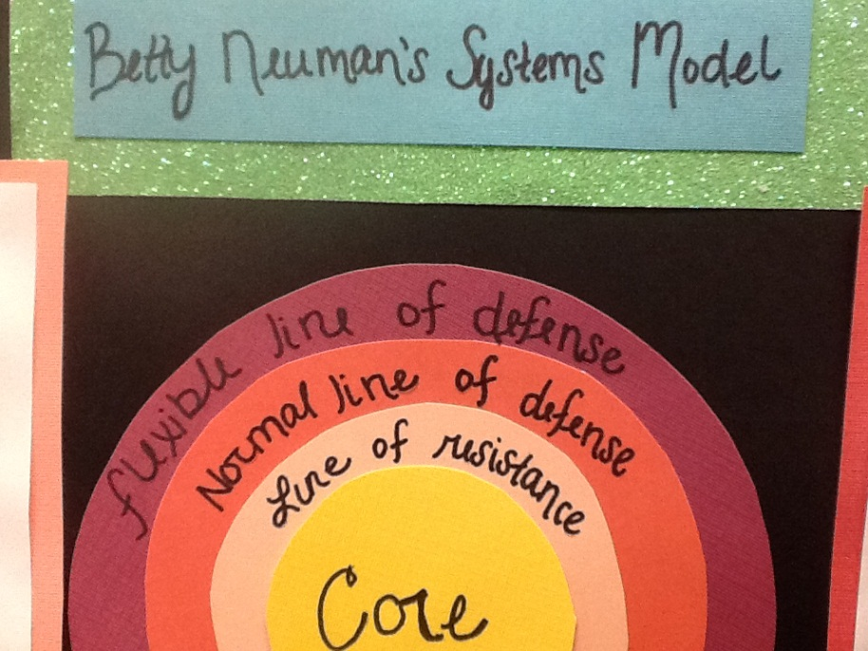
Staff education
applied NSM to assess stressors identified in the staff survey
show how they
can penetrate the
normal line of defense
Explained what each line of defense meant and how it can have an effect on the staff and patients
(Neuman, 2011)

Slide 44
serves the public interest
assess and identify programs that engage in effective educational practices
voluntary, self-regulatory process
encourages continuing self-assessment
supports continuing growth and improvement
Review the FINAL DRAFT of the Proposed Standards for Accreditation of Baccalaureate and Graduate Nursing Programs (March 2013)

Slide 45
National League for Nursing Accrediting Commission, Inc. has a NEW name.
Effective May 6, 2013, the NLNAC changed its name and is now the Accreditation Commission for Education in Nursing (ACEN)
The goal of accreditation [USA] is to ensure that education provided by institutions of higher education meets acceptable levels of quality. Here you will find lists of regional and national accrediting agencies recognized by the U.S. Secretary of Education as reliable authorities concerning the quality of education or training offered by the institutions of higher education or higher education programs they accredit.
http://www2.ed.gov/admins/finaid/accred

Slide 46
Canadian Association of Schools of Nursing (CASN)
The Canadian Association of Schools of Nursing is the national accrediting body for nursing education in Canada. In 1987, the organization accredited its first undergraduate program and today, the accreditation of nursing education programs in Canada has become a core function of CASN. http://www.casn.ca/en/

Slide 47
CASN - Undergraduate nursing students create mental health app, receive inaugural Student e-Health Leadership Award
Award recognizes leadership in adoption and use of information and communications technologies among undergraduate nursing students
Http://www.casn.ca/en/Whats_new_at_CASN_108/items/140.html
“Canadian nursing students are learning from the beginning of their baccalaureate education to embrace change and advancement in technology to best serve our practice,” said Lise Schultz, Vice President of the Canadian Nursing Student Association. “This year we were thrilled to present the CASN/ Infoway joint award recognizing the technological skill set that the next generation of nurses are bringing to Canadian health care.”

Slide 48
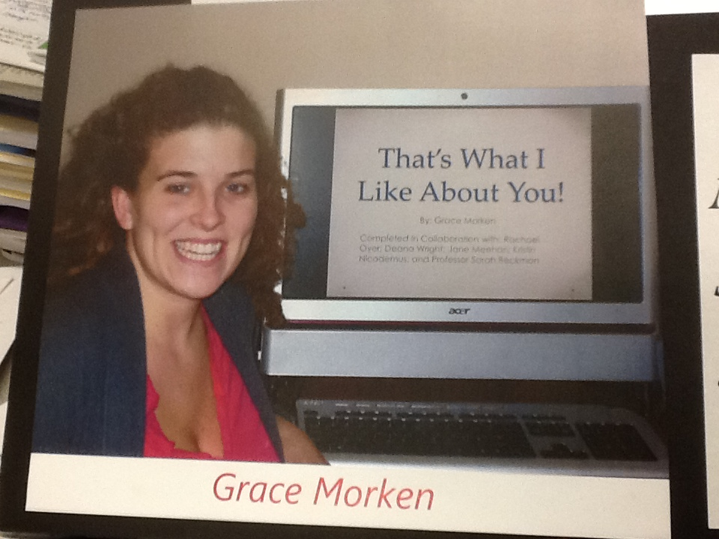
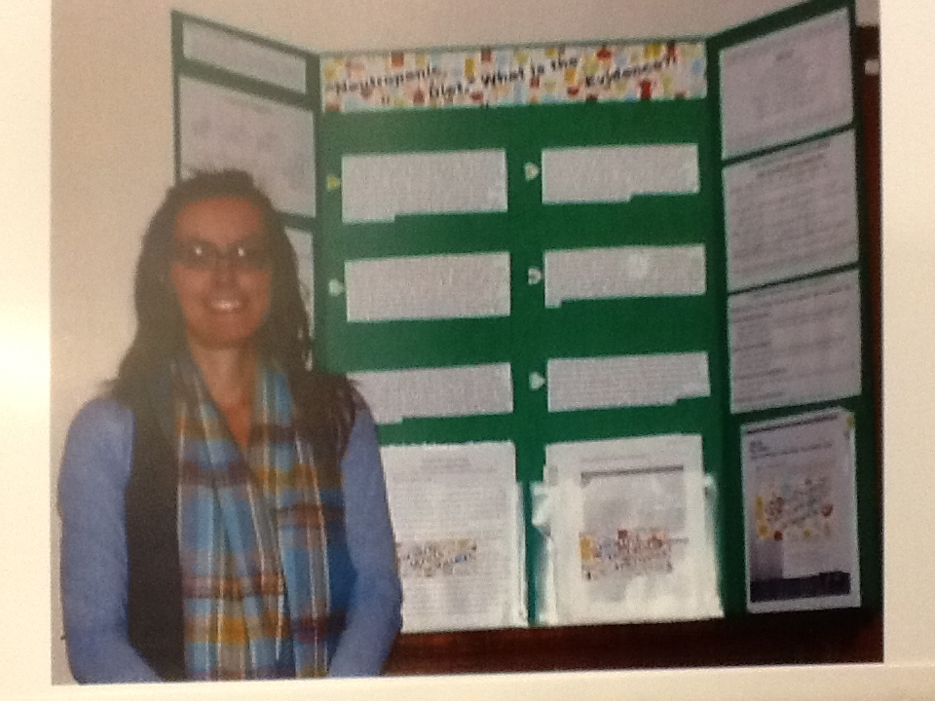
Inter- Intra-

Slide 49
Extra-personal Stressors

Slide 50
Intra-, Inter-, Extra-personal stressors

Slide 51
Hello Prof. Beckman,
Thanks for your continued support, recognition and inspiration for the future. I hope I will have the chance to be one of your preceptors for the Leadership course someday. It would be an honor.
I hope your trip to Vancouver is a success and I know it will be. I am so pleased that Maria Wright is going too, she is a great leader.
Take Care and I will keep in touch,
Heather Hicks

Slide 52
Inspirations in Education
Heidi Buffenbarger
Identify preventions as interventions used by instructors to prevent system instability in the nursing student community
Identify preventions as interventions used by nursing students to prevent system instability within the individual.
Identifying Nursing Student Stressors and Interventions Using the Neuman Systems Model

Slide 53
Inspirations in Education
Maria Wright
NSM in Education: Energizing Teacher and Student Learning Outcomes
Identify how the NSM is applied to meet diverse learning needs.
Identify how technology can be used to engage both teacher and learner.
Discuss successful strategies in dealing with math anxiety.

Slide 54
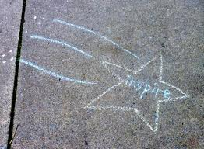
Teaching at its best strives to
genuine fascination with the subject
a sense of relevance and applicability to life and the world
a sense of accomplishment in mastering it
a sense of calling to it
(Nilson, 2010, p.51)

Slide 55
Select References (journal articles)
Beckman, S., Boxley-Harges, S., & Kaskel, B. (2012).
Experience informs: Spanning three decades with the NSM. Nursing Science Quarterly. 25(4), 341-346.
Salmon, B., Bruik-Sorge, C., Beckman, S., & Boxley-Harges, S. (2010). The evolution of student nurses’ concepts of spirituality. Holistic Nursing Practice, 24(2), 73-78.
Beckman, S., Boxley-Harges, S., Bruick-Sorge, C., & Salmon, B. (2007). Five strategies that heighten nurses’ awareness of spirituality to impact client care. Holistic Nursing Practice, 21(3), 135-139.
Lowry, L., Beckman, S., Gehrling, K. R., & Fawcett, J. (2007). Imagining nursing Practice: The Neuman Systems Model in 2050. Nursing Science Quarterly, 20(3), 226-229.

Slide 56
References (chapters)
Beckman, S., Boxley-Harges, S., Bruick-Sorge, C., & Eichenauer, J. (1998). Critical thinking, the Neuman Systems Model, and associate degree education. In Lowry, L. (Ed.) The Neuman Systems Model and nursing education: Teaching strategies and outcomes. (pp. 53-58) Indianapolis, IN: Center Nursing Press.
Beckman, S., Boxley-Harges, S., Bruick-Sorge, C., & Eichenauer, J. (1998). Evaluation modalities for assessing student and program outcomes. In L.W.Lowry (Ed.) The Neuman Systems Model and nursing education: Teaching strategies and outcomes. (pp. 149-160). Indianapolis, IN: Center Nursing Press.
Beckman, S.J., Boxley-Harges,S., Bruick-Sorge, C., Harris, S. M., Hermiz, M. E.,
Meininger, M., & Steinkeler, S. E. (1998). Betty Neuman Systems Model. In A.
Marriner-Tomey & M. R. Alligood, Nursing theorists and their work (4th ed., pp. 269-304). St. Louis, MO: C.V. Mosby.

Slide 57
References (chapters cont)
Beckman, S., Boxley-Harges, S., & Bruick-Sorge, C. (1994). Betty Neuman: The Neuman Systems Model. In A. Marriner-Tomey (Ed.), Nursing theorists and their work (3rd ed.) (pp.269-304). St. Louis, MO: C. V. Mosby
Beckman, S., Lowry, L., & Boxley-Harges, S. (2011). Nursing education at Indiana University-Purdue University Fort Wayne. In B. Neuman & J. Fawcett (Eds.), The Neuman Systems Model) (5th ed., pp. 194-215). Upper Saddle River, NJ: Pearson Education.
Beckman, S., Chapman-Boyce, P., Coleman-Ehmke, S., Hailway, C., & Pung, R. (1986). Joyce J. Fitzpatrick: Life Perspective Model. In A. Marriner-Tomey and M.A. Alligood (Eds.), Nursing theorists and their work (1st ed.). St. Louis, MO: C. V. Mosby.

Slide 58
Conference Proceedings (engagement, millenial, educational technologies)
Beckman, S. & Boxley-Harges, S. Challenges of Engaging 21st Century Students: Strategies that Work. Great Lakes Conference on Teaching and Learning. Mt. Pleasant, Michigan. May 9-11, 2012
Beckman, S., Bruick-Sorge, S. & Bane, T. iSMART: Intergenerational Students Motivated to Apply Research and Technology. Great Lakes Conference on Teaching and Learning. Mt. Pleasant, Michigan. May 9-11, 2012
Beckman, S., Bruick-Sorge, C., and Bane, T. Millenials educated and empowered with technology. The 11th Annual National Lilly Conference on College and University Teaching and Learning. Traverse City, Michigan. September 22-25, 2011.
Beckman, S., Bruick-Sorge, C., and Bane, T. Student created websites: Demonstration of Information Literacy Skills. The 2011 Fort Wayne Teaching Conference: Beyond Power Point – Incorporating Innovative Technology to Enhance Student Learning. Fort Wayne, Indiana. February 25, 2011.

Slide 59
Additional References
Alligood, M. & Tomey, A. (2010). Nursing theorists and their work (7th ed.). Maryland Heights, Missouri: Mosby Elsivier.
Goleman, D. (1998). Working with emotional intelligence. New York, NY: Bantam Books.
Healy, S. & Tyrell, M. (2011). Stress in emergency departments: Experiences of nurses and doctors. Emergency Nurse. 19 (4), 31-37.
Keep Calm and Carry On (2011). Retrieval on 20 March 2013 from. Http//www.keepcalmandcarryon/history/
Keller, J. M. (2008). An integrative theory of motivation, volition, and performance. Technology, Instruction, Cognition, and Learning, 6, 79-104.
Knowles, M. (1990). The adult learner: A neglected species. Houston, Texas: Gulf Publishing.
Nilson, L. (2010). Teaching at its best: A research-based resource for college instructors. San Francisco, CA: Jossey-Bass.
Neuman, B. & Fawcett, J. (2011). The Neuman Systems Model (5th ed.). Boston, MA: Pearson.
Whitehead, D., Weiss, S., & Tappen, R. (2010). Essentials of nursing leadership and management (5th ed.). Philadelphia, PA: F.A.Davis Co.

Slide 60
Inspirations in Education Zwolle, The Netherlands

Slide 61
Inspirations in Education Hasselt, Belgium

Slide 62
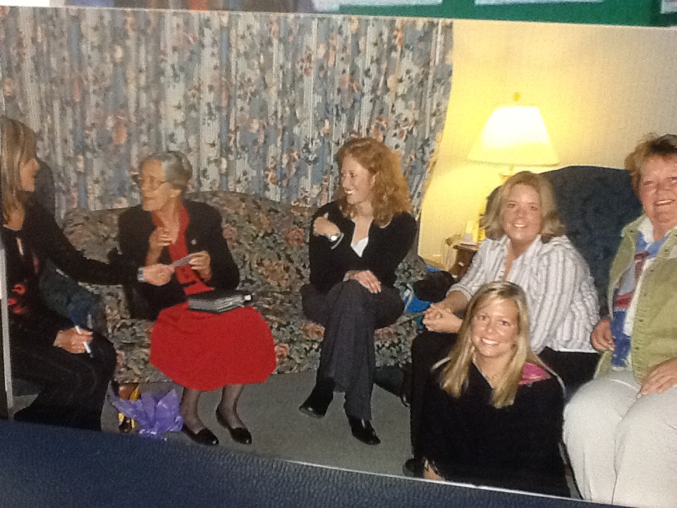
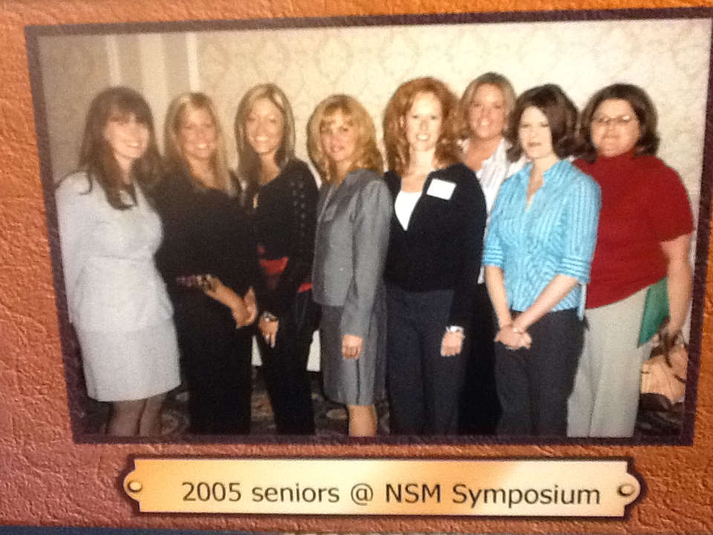

Slide 63
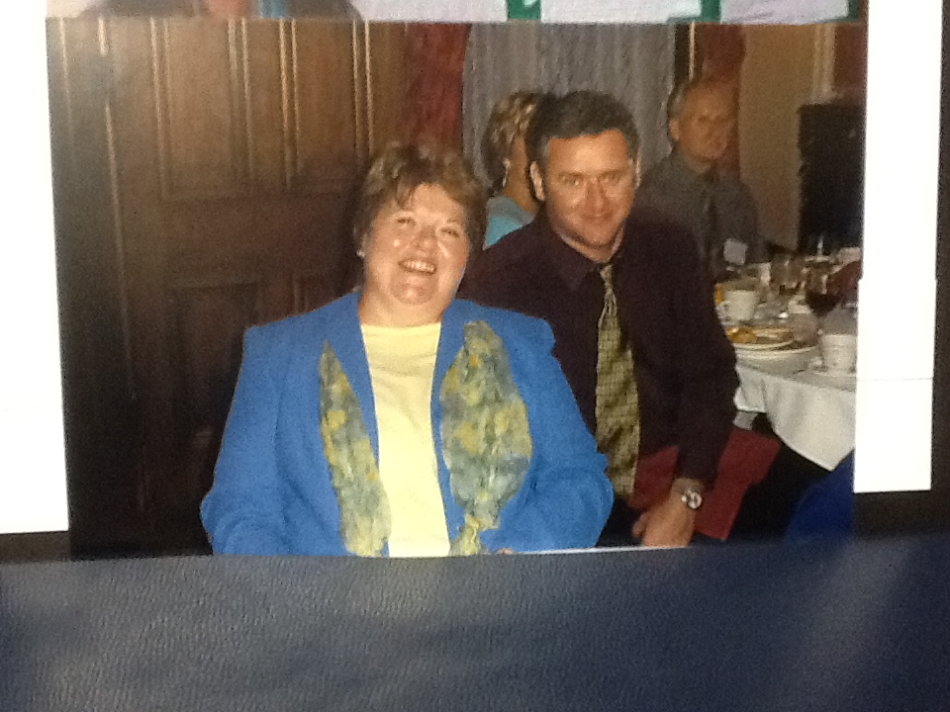
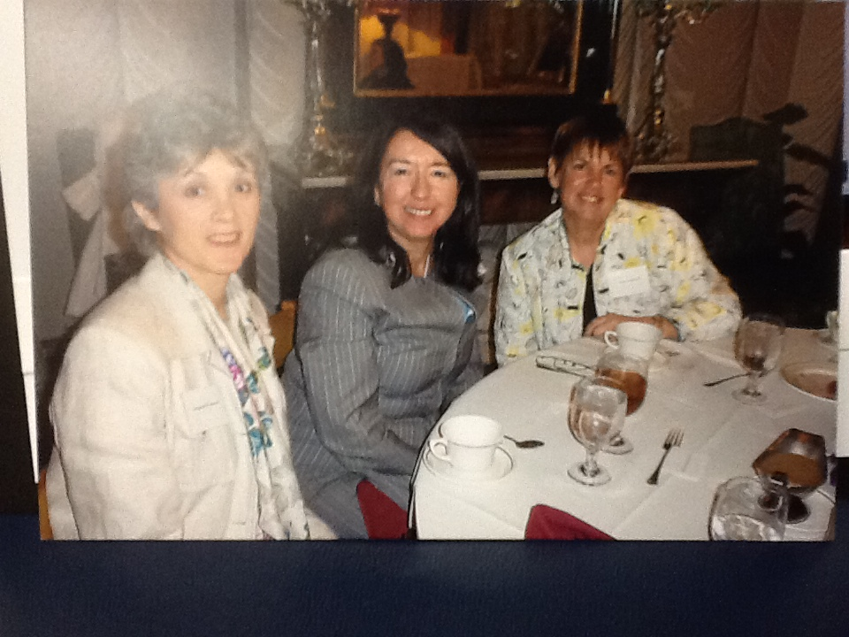

Slide 64
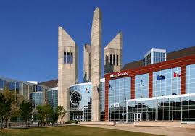

Slide 65
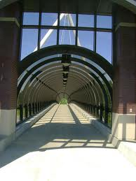
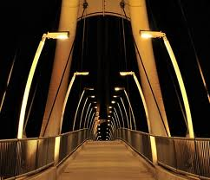

Slide 66
###

