Slide 1
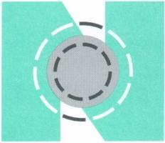
15th International Biennial Neuman Systems Model Symposium Preventions: A Global Perspective
Philadelphia, Pennsylvania, USA
June 18-20, 2015

Slide 2
NSM Application: Coaching Students to Grasp and Use Abstract Concepts
Sarah Beckman, MSN, BS, RN
Associate Professor
NSM Trustee
In collaboration with:
Amy Barnes
Zoey Dressel
Mariah Feasel
Allissa Smith

Slide 3
Acknowledgements
STUDENTS
Whitney Beiswanger & Abigail Pfaff
ALUMNI
Maria Wright & Heidi Buffenbarger (sp 2013)
Nick Redding & Cortnie Jordan (fa 2014)
TEACHING TEAM
Dawn Pla, BS, RN, Teaching Assistant
Johnathan Liechty, MBA, BSN, RN, Limited Term Lecturer
Jolene Nash, MS, BS, RN, Limited Term Lecturer

Slide 4
Objectives
Identify five strategies that apply Keller’s ARCS-V Model for Motivation to engage students in the exploration of theory-based approaches and application of abstract concepts in nursing activities.
Apply NSM concepts in a quality improvement project featuring primary preventions as interventions to target prioritized client stressors of a small group of nursing students (~8) and a pre licensure nursing student body (~400).
Invite participants to provide feedback on the efficacy of the NSM as a guiding framework for use by students and faculty to build relationships, community, and connectedness among nurses.

Slide 5
Coaching Students to Grasp and Use Abstract Concepts (Context)
Bachelor of Science Pre licensure students
400 level leadership course (5 credits)
3 credits didactic; hybrid delivery
2 credits - 90 hour clinical (over 13 wks)
Preceptorship Model
Student/Preceptor/Professor
Preceptors – clinical faculty (100, 200, 300)
(Ulrich, 2012; Keller, 2008; Weimer, 2013)

Slide 6
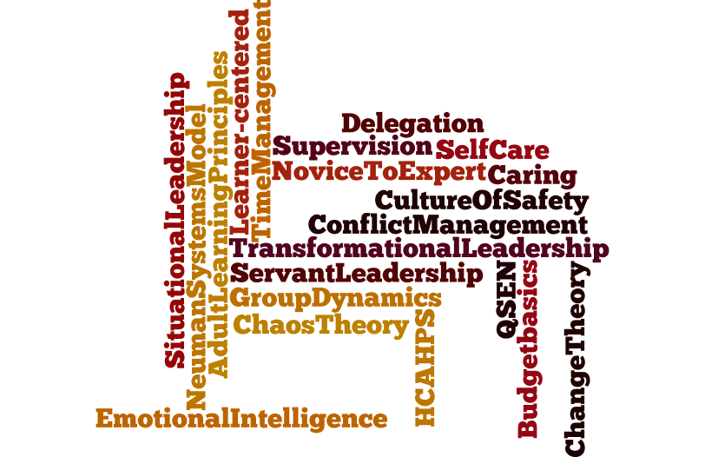
Abstract Concepts
(Whitehead, Weiss, & Tappen, 2010; Milstead & Furlong, 2006; Porter-O’Grady & Malloch, 2016; Neuman & Fawcett, 2011; Studer, Robinson & Cook, 2010; Weimer, 2013; Goleman, 1998; www.wordle.net

Slide 7
ARCS-V MODEL
Attention – learner perceives a gap in knowledge, curiosity aroused.
Relevance – knowledge is meaningfully related to her/his goals.
Confidence – self-efficacy - believe can be successful in learning task.
Satisfaction – Anticipation is followed by experience of satisfying outcomes.
Volition – self-regulatory strategies to protect intentions, competing goals can interfere with persistence.
(Keller, 2008)

Slide 8
What 5 strategies? #1 Attention
Gap in knowledge
NSM applied to group of nurses (vs. patient)
Leadership theories
Preceptorship with faculty in clinical setting
Arouse curiosity
Alumni students sharing
Stressors – hear, feel, see, taste, smell
(Benner, Sutphen, Leonard, & Day, 2010; Keller, 2008; Knowles, 1990; Nilson, 2010; Weimer, 2013; Neuman & Fawcett, 2011)
Need a Grabber

Slide 9
#2 Relevance
Make transparent how subject matter (NSM, leadership, etc) is connected to real world.
Make connection between acquiring and using knowledge and integrating the classroom with clinical practice
Reality-based – real world, real time
(Benner, Sutphen, Leonard, & Day, 2010; Keller, 2008; Knowles, 1990; Nilson, 2010; Weimer, 2013; Neuman & Fawcett, 2011)
So, how will this help me be a better nurse?

Slide 10
#3 Confidence
Realistic expectations, clear guidelines, assignments, rubrics
Apply NSM - nursing stud grp
Reinforcement with +/- fdbk
Learner-controlled elements
Opportunities for increased learner independence
(Benner, Sutphen, Leonard, & Day, 2010; Keller, 2008; Knowles, 1990; Nilson, 2010; Weimer, 2013; Neuman & Fawcett, 2011)
I am “just” a student.
How can I lead and teach and make change?

Slide 11
#4 Satisfaction
Apply NSM!!
Build on prior learning
Apply leadership principles
Collaborative learning with peers
Include recognition
Timely feedback; scheduled visits with student/preceptor
Require reflection
(Benner, Sutphen, Leonard, & Day, 2010; Keller, 2008; Knowles, 1990; Nilson, 2010; Weimer, 2013; Neuman & Fawcett, 2011)
What can “I” do to make a difference?

Slide 12
#5 Volition
Critical teaching moments – faculty engaged and alert
Provide human resources
Alumni, preceptors
Faculty time -email/text/ph/F2F
Reinforce when abstractions are interpreted and applied correctly.
Be enthusiastic, encouraging
(Benner, Sutphen, Leonard, & Day, 2010; Keller, 2008; Knowles, 1990; Nilson, 2010; Weimer, 2013; Neuman & Fawcett, 2011)
What will it take for me to stay on task?
Competing goals, distractions.

Slide 13
Coaching Students to Grasp and Use Abstract Concepts
Trust students, smart, want to give their best
Freedom to be risk takers, room for error
Learner-centered
Partner student/faculty/preceptor
Listen to students
Mutual respect
Require Written Reflection EQ self assess, Journal Entries, QI Paper

Slide 14
Got Stress?
A Wellness Neuman Model Approach for Reducing Nursing Students’ Stressors:
Building Upperclassmen and Underclassmen Relationships
http://prezi.com/9ivvooqhmeip/?utm_campaign=share&utm_medium=copy&rc=ex0share

Slide 15
Got Stress? Contact us
Amy Barnes barnaj02@students.ipfw.edu
Whitney Beiswanger mastwg01@students.ipfw.edu
Zoey Dressel dreszl01@students.ipfw.edu
Mariah McMillen mcmima01@students.ipfw.edu
Abby Pfaff pfafal01@students.ipfw.edu
Allissa Smith smitam31@students.ipfw.edu
Professor Sarah Beckman beckmans@ipfw.edu

Slide 16
References
Goleman, D. (1998). Emotional intelligence: Working with emotional intelligence. New York, NY: Bantam Books.
Keller, J. M. (2008). First principles of motivation to learn and e3-learning. Distance Education, 29:2,175-185.
Knowles, M. (1990). The adult learner: A neglected species. Houston, TX: Gulf Publishing.
Milstead, J., & Furlong, E. (2006). Handbook of nursing leadership: Creative skills for a culture of safety. Sudbury, MA: Jones and Bartlett Publishers.
Morrison, J. (2008). The relationship between emotional intelligence competencies and preferred conflict-handling styles. Journal of Nursing Management, 16, 974-983.
Neuman, B., & Fawcett, J. (2011). The Neuman Systems Model (5th ed.). Upper Saddle River, NJ: Pearson.
Nilson, L. (2010). Teaching at its best: A research-based resource for college instructors. San Francisco, CA: Jossey-Bass.
Porter-O’Grady, T., & Malloch, K. (2016). Leadership in nursing practice: Changing the landscape of health care (2nd ed.). Burlington, MA: Jones & Bartlett Learning.
Studer, Q., Robinson, B., & Cook, K. (2010). The HCAHPS handbook. Gulf Breeze, FL: Fire Starter Publishing.
Ulrich, B. T. (2012). Mastering precepting: A nurse’s handbook for success. Indianapolis, IN: Sigma Theta Tau International.
Weimer, M. (2013). Learner centered teaching: Five key changes to practice. Indianapolis, IN: Jossey- Bass.
Whitehead, D., Weiss, S., & Tappen, R. (2010). Essentials of nursing leadership and management. (5thed.). Philadelphia, PA: F.A. Davis Company.

