Slide 1
14th Neuman Systems Model International Biennial Symposium
The Neuman Systems Model: A Force for Energizing Nursing Practice, Research, Teaching, and Administration
June 6-8, 2013.
Vancouver, British Columbia
Canada

Slide 2
College of Health and Human Services
Department of Nursing
Sarah J. Beckman
Associate Professor
beckmans@ipfw.edu
Sanna Boxley-Harges
Professor Emeriti
lharges@embarqmail.com

Slide 3
Theory-driven Student Engagement: Challenges, Complexities, and Cultural Competence

Slide 4
Participant outcomes:
Discuss challenges of student engagement on multicultural and diversity topics.
Identify the force of utilizing nursing and learning theories to drive instructional design of a transcultural healthcare course.
Examine the components of this course that specifically contribute to IOM recommendations and QSEN knowledge, skills, and attitude goals in healthcare delivery to peoples from diverse backgrounds.

Slide 5
Participant outcomes (continued)
Identify ground rules for creating a safe learning environment.
Identify multiple teaching strategies evolving from evidence-based adult learning principles for self and multicultural exploration.
Examine classroom assessment findings on learning preferences.

Slide 6
Overview
Challenges and complexities of engaging students on real world culturally sensitive topics in a general education transcultural healthcare course are the essence of this presentation.

Slide 7
Transcultural Healthcare (3 credits)
General education course
Required in some curricula
Traditional classroom F2F
(in progress - transforming for distance delivery)
Limited to 35 students
Students themselves (diversity of cultures)

Slide 8
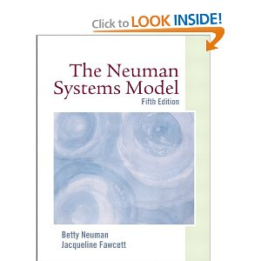
Theory-driven student engagement:
Neuman Systems Model
As the overarching wholistic model,
the NSM provides the professional
nursing and interdisciplinary
healthcare team framework.
Wholistic Client Variables: Physiological, Psychological, Socio-cultural, Developmental, Spiritual
Environment: Intra-, Inter-, Extra- personal and Created Environment
Health: Homeostasis, Reconstitution
Nursing Preventions as Interventions: Primary, Secondary, Tertiary

Slide 9
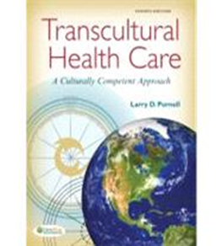
Purnell Model for Cultural Competence
provides specificity within cultural domains
http://www.salisbury.edu/nursing/haitiancultcomp/purnellsmodel.htm
http://personal.psu.edu/dcj11/blogs/psu_behrend_nursing_
department_journal_club/Journal%20of%20
Transcultural%20Nursing%20Purnell%20Model.pdf

Slide 10
Purnell’s 12 Domains of Culture
Overview, inhabited localities, topography
Communication
Family roles and organization
Workforce issues
Biocultural ecology
High-risk behaviors
Nutrition
Pregnancy and child bearing practices
Death rituals
Spirituality
Health-care practices
Health-care providers
(Purnell, 2013)

Slide 11
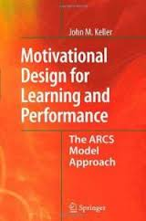
Keller’s ARCS Model
for Motivation
is utilized to assure intentional selection of
teaching/ learning strategies
which promote student engagement and learning outcomes
http://www.arcsmodel.com/Mot%20dsgn.htm
http://www.kineo.com/elearning-tips/tip-33-a-shot-of-theory-kellers-arcs-model.html
By attending to the four variables that influence motivation - attention, relevance, confidence and satisfaction - you can create a program that's aligned to a learner's needs and keeps them focused and engaged.

Slide 12
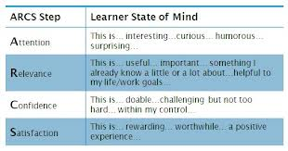
ARCS – for motivation

Slide 13
ARCS: Relevance and Attention
To this end,
faculty must strive to connect subject matter to reality-based situations relevant to the real world.
(Keller, 2008; Nilson, 2010; Knowles, 1990; Whitehead, Weiss, & Tappen, 2010)
On the other hand, often overlooked is the necessity of targeting the affective domain with its challenges of exploring sensitive issues, emotions, and feelings. Connectedness may feel uncomfortable.
(Fawcett & Neuman, 2011; Keller, 2008; Nilson, 2010)

Slide 14
Challenges & Complexities:
When considering teaching/learning strategies for a course in which culturally sensitive topics are at the forefront, it is imperative to select strategies for
creating a safe environment in which students are free to state beliefs and opinions
holding students accountable to listen and respect diverse viewpoints
stimulating student interest in subject (cognitive)
exploring sensitive issues, emotions, feelings (affective)
To this end, utilization of ground rules on civility and evidence-based principles will be explored in relation to the instructional design.
Notes:
The creation of a safe environment makes it possible to push the boundaries in exploring values, norms, and cultural diversity.

Slide 15
Creating a Safe Environment
What is said in here, stays in here (confidentiality)
Don’t ugh someone else’s Ah-h (respect for diverse views)
One speaker at a time
(mutual respect)
Active participation
(listening, sharing, collaborating)
Ground Rules for Civility
Notes:
Ground rules must incorporate self responsibility, accountability to others, confidentiality, mutual respect, and safety for openness, self disclosure, and diversity of views.
The creation of a safe environment makes it possible to push the boundaries in exploring values, norms, and cultural diversity.

Slide 16
Instructional Design Teaching Strategies
My Story (individual)
(ARCS: Attention & Relevance)
Group Culture Project (small group, online discussion forum, present in class, audience participation) (ARCS: Confidence)
Intercultural Interview/Assessment (individual, includes client) (Confidence & Satisfaction)
(Keller, 2008)

Slide 17
To explore cultures effectively,
it is imperative for the student
first to develop a self awareness
of his or her own
cultural background.
(Purnell, 2013; Purnell & Paulanka, 2008;
Giger & Davidhizer, 2008; Spector, 2009)

Slide 18
My Story (ARCS: Attention & Relevance)
Self exploration of own history and cultural background
Reflect on any biases or assumptions
Family tree
“to thine own self be true” (Shakespeare)
Such self exploration sets the stage for holistically exploring the cultures of other peoples.
Notes:
“Many theorists and diversity trainers imply that self-examination or awareness of personal prejudices and biases is an important step in cognitive process of developing cultural competence.” (Purnell, 2013, p.45)

Slide 19
Group Culture Project (ARCS: Confidence)
Collaborative learning with peers (4-6)
Use of Discussion Board to facilitate communication, leaves crumbs
Culture presentation
Presenters identify effectiveness of engagement strategies used (often need faculty prompting)
Audience critique major learning points and submit to presenters
Reflection paper

Slide 20
Beyond student led discussion,
skillful faculty management of discussions to maximize active participation is of utmost importance with discussion being defined as "a productive exchange of viewpoints, a collective exploration of issues"
(Nilson, 2010, p. 127).

Slide 21
Intercultural Interview/Assessment (Confidence & Satisfaction)
Individual assignment
Build on prior learning (previous assignments)
Secure interviewee from culture other than own
Use evidence-based interview tool
Apply socio-cultural models to analysis of data
(Purnell & Paulanka, 2008; Neuman & Fawcett, 2011)
Oral sharing in class

Slide 22
Strategically applied teaching methodologies
further enhance student engagement to expand awareness, develop sensitivity, and begin to understand and interact with people from diverse backgrounds.

Slide 23
Outcomes of cultural awareness & sensitivity:
Institute of Medicine (IOM) recommendations
http://www.iom.edu/About-IOM.aspx
Quality and Safety Education for Nurses (QSEN) knowledge, skills, and attitude
http://www.aacn.nche.edu/faculty/qsen/competencies.pdf
(Patient-centered care p.11)
http://www.nursingworld.org/MainMenuCategories/ANAMarketplace/ANAPeriodicals/OJIN/TableofContents/Vol-16-2011/No3-Sept-2011/Teaching-and-Safety.html
21st Century Nursing Practice
in acute, chronic, community, and education settings
http://www.who.int/ethics/en/
http://nursingworld.org/MainMenuCategories/EthicsStandards/CodeofEthicsforNurses/Code-of-Ethics.pdf (Provisions 1 & 8)

Slide 24
IOM and QSEN
Patient-centered care
Collaboration and interdisciplinary teamwork
Evidence-based practice
Quality improvement
Informatics
Safety

Slide 25
Evidence-based teaching Adult Learning Principles
Build on prior learning
Reinforcement with positive and/or corrective feedback
Active participation
Timely, relevant, and reality-based
Collaborative learning with peers
Simple to complex
General to specific
Creativity
(Knowles, 1990)

Slide 26
Classroom Assessment informs the instructional design and completes the feedback loop
“Teaching to different learning styles is a major factor of equity”
(Nilson, 2010, p.229)

Slide 27
Classroom Assessment
Preferred learning methods (11 items)
N=136 (five sections over three semesters)
Identify all preferred learning methods
Identify least preferred learning methods
Rank #1, #2, #3 preferred learning methods (top three)

Slide 28
Spring/Fall 2011/Spring 2012 Classroom Assessment
NUR 30900: Transcultural Health Care
Students (N=136, 5 Sections) Ranking of Preferred Learning Methods

Slide 29
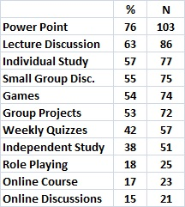
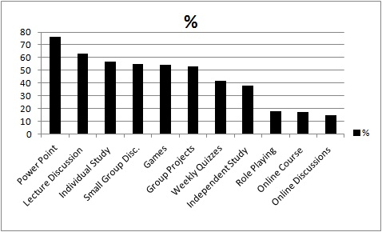
All Preferred Lear
All Preferred Learning Methods

Slide 30
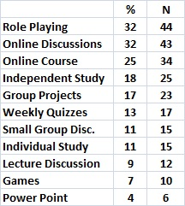
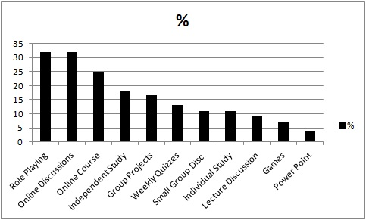
All Preferred Lear
Least Preferred Learning Methods

Slide 31
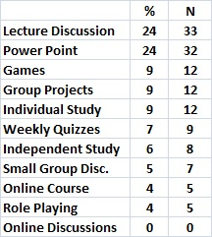
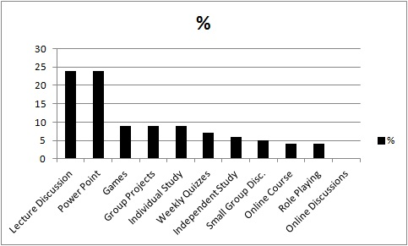
Ranked 1st Learning Methods

Slide 32
Summary
Challenges and proactive strategies have been examined.
Theory-driven instructional design was featured.
Adult learning and engagement principles were applied effectively.
Ultimate engagement must come from within the student.
Faculty assure a safe environment for exploring sensitive topics, differing views on real world matters through the use of ground rules.
Preliminary findings support educational methodologies embedded in this transcultural course.

Slide 33
Parting Thoughts
Beckman & Harges, 2013
(Nilson, 2010, p.51)
This vision can only be experienced in partnership between faculty/student, students/students, and students/people from diverse backgrounds.
Only then will the educational goals of expanding awareness, sensitivity, and beginning cultural competence be realized.
Anticipated outcomes are to "induce genuine fascination with the subject, a sense of relevance and applicability to life and the world, a sense of accomplishment in mastering it, and a sense of calling to it“.

Slide 34
References
Giger, J. N. & Davidhizar, R. E. (2008). Transcultural Nursing: Assessment and intervention (5th ed.). St. Louis, MO: Mosby Elsevier.
Keller, J. M. (2008). An integrative theory of motivation, volition, and performance. Technology, Instruction, Cognition, and Learning, 6, 79-104.
Knowles, M. (1990). The adult learner: A neglected species. Houston, Texas: Gulf Publishing.
Nilson, L. (2010). Teaching at its best: A research-based resource for college instructors. San Francisco, CA: Jossey-Bass.
Neuman, B. & Fawcett, J. (2011). The Neuman Systems Model (5th ed.). Boston, MA: Pearson.
Purnell, L. (2013). Transcultural health care: A culturally competent approach (4th ed.). Philadelphia, PA: F. A. Davis Company.
Purnell, L. D. & Paulanka, B. J. (2008). Transcultural health care: A culturally competent approach (3rd ed.). Philadelphia, PA: F. A. Davis Company.
Spector, R. E. (2009). Cultural diversity in health and illness (7th ed.). Upper Saddle River, NJ: Pearson Prentice Hall.
Whitehead, D., Weiss, S., & Tappen, R. (2010). Essentials of nursing leadership and management. Philadelphia, PA: F.A.Davis Co.

Slide 35
We are interested in hearing your perspectives on (as time allows)
…your success and failures in engaging students
…more specifically with culturally sensitive topics
“In your opinion, why is there conflict about working with culturally diverse patients?”
“What attitudes are necessary to delivery quality care to patients whose culture is different from yours?”
(Purnell, 2013, p.45)
What factors create barriers to patient-centered care? http://www.aacn.nche.edu/faculty/qsen/competencies.pdf (p.11)

